Slide 1
Rule 1.00
OBJECTIVES OF THE GAME

Slide 2
RULE 1.00
1.01 Baseball/Softball is a game…
Teams at minimum must have 9 players and 1 adult. At maximum, 3 adults.
Games must have at minimum 1 umpire.
Games must be played on regulation fields with regulation equipment.
For DSUA purposes, both managers will sign off on the voucher certifying these requirements are being followed.

Slide 3
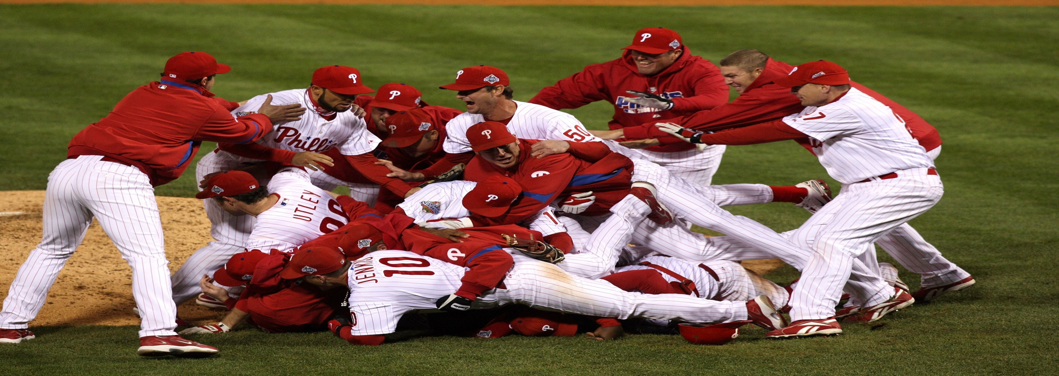
RULE 1.00
1.02 – The objective of each team is to win by scoring the most runs.
1.03 – The winner will be the team with the most runs scored.

Slide 4
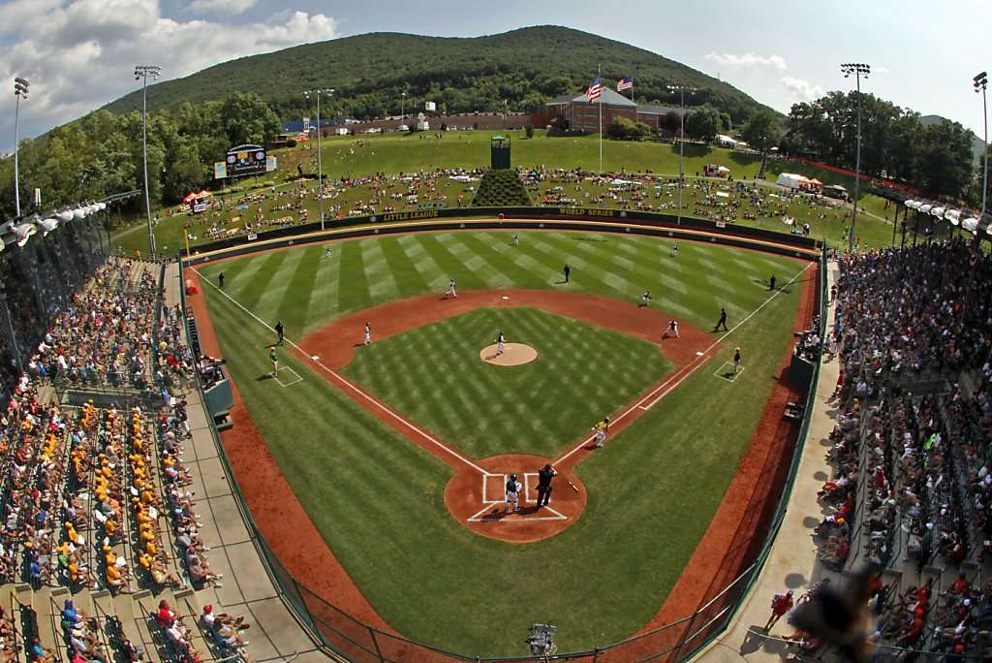
Rule 1.00
1.04 – The playing field

Slide 5
Rule 1.04
Little League 46/60 field
46 feet pitching distance (from front of pitchers plate to point of home plate)
Mound should be 6 inches higher than plate
60 foot base paths
Batter’s box is 6 feet long and 3 feet wide.
Catcher’s box : 1st and 3rd extended foul lines 9 feet from the point of the plate. Straight line across connects the lines to form the back of the box.
Field should be 200 feet or more to the poles and center field.
If there is an outfield fence, it should be a minimum 4 feet tall.
Runner’s lane: 2.5 feet wide beginning 30 feet from the base to the base.

Slide 6
LL 46/60 Plate Diagram

Slide 7
Rule 1.04
Junior/Senior 60/90 field
60 feet 6 inch pitching distance.
Mound should be 10 inches above home plate.
90 foot base paths.
Batter’s box is 6 feet long and 4 feet wide.
Catcher’s box: Extends 8 feet from the point of the plate. 43 inches wide.
Field should be 300 feet long to the poles and center field.
If there is an outfield fence, it should be a minimum 4 feet tall.
Runner’s lane: 3 feet wide beginning 45 feet from first base to the base.

Slide 8
LL 60/90 Plate Diagram

Slide 9
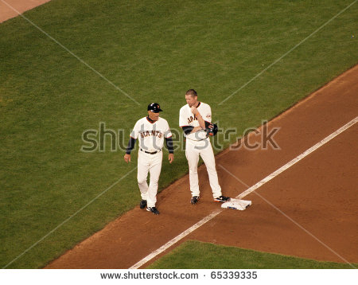
Rule 1.04 – Additional Items
Base Coach Boxes: Major division – 4 foot by 8 foot. Jr/Sr – 10’ x 20’
Coaches Box: No closer than 6 feet from the foul line.
Keep Coaches in the box at the right times.

Slide 10
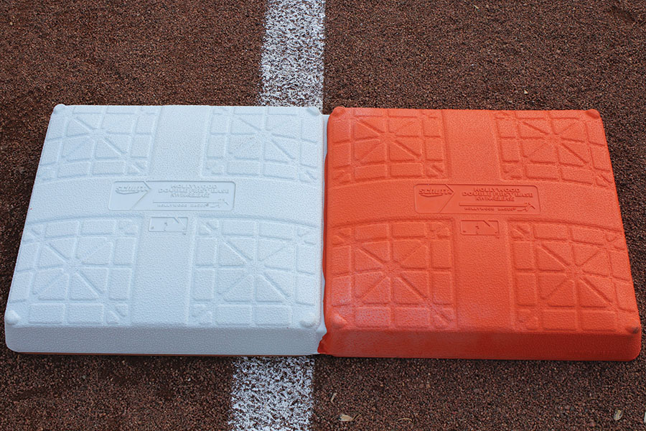
Rule 1.00
1.05 – Home Plate is 17 inches wide.
1.06 – Bases are 14-15 inches square and no more than 2 ¼ inches thick. Bases must be soft in material and must disengage from anchor for safety.
Notes:
If the base disengages, a player may use the original location or where the base is currently laying to define a touch or occupation.
The use of the “double first base” is allowed.

Slide 11
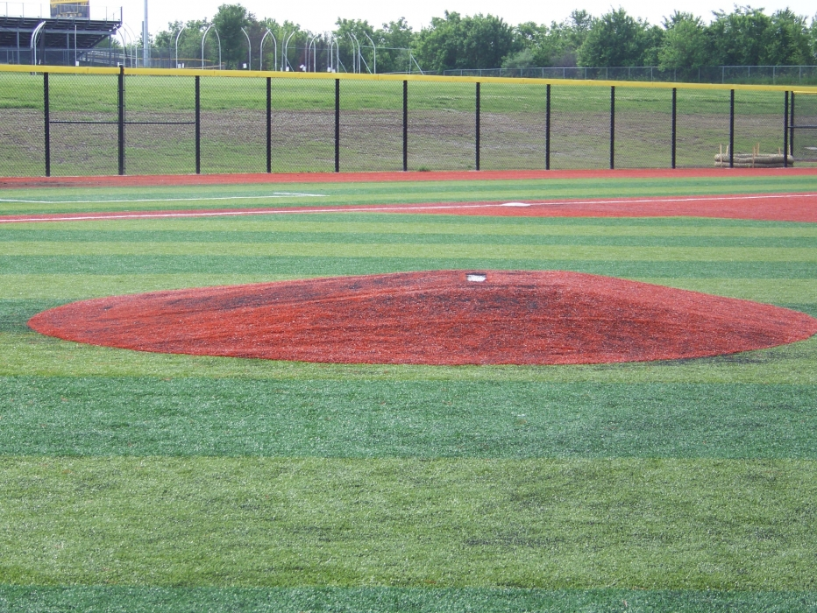
Rule 1.00
1.07 – The pitchers plate
Shall be made of white rubber.
Shall be 18 inches by 4 inches in Major Baseball
Shall be 24 inches by 6 inches in Junior/Senior Baseball.
Portable mounds are allowed (Regular Season Only)

Slide 12
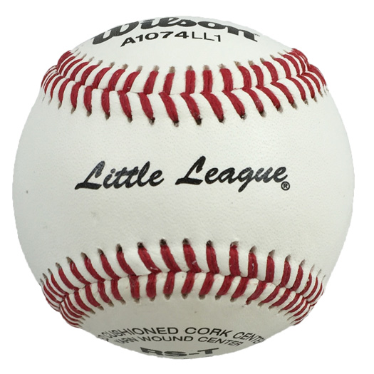
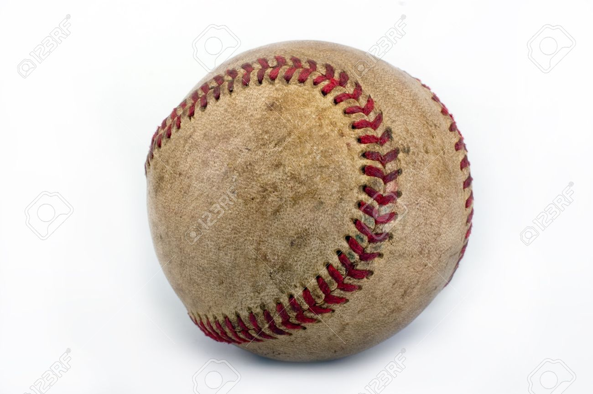
Rule 1.00
1.08 – All Players MUST remain in the dugout.
No on-deck area in Major Baseball.
On-deck areas should be in a safe location. Only one player may occupy.
Only 1 player is allowed to swing in front of the dugouts in between innings.
1.09 – Baseballs
Must weigh 5 – 5 ¼ ounces.
Must be 9 – 9 ¼ inches in circumference.
North Interleague – Baseballs MUST be officially licensed and stamped “Senior LL”
Make sure the balls are free of cuts, nicks, and aren’t completely brown.

Slide 13
Rule 1.00
1.10 – Bats
Major Baseball – 2 ¼ inch barrel. No longer than 33 inches. BPF 1.15 or less.
Jr Baseball – 2 5/8 inch barrel. No longer than 34 inches. Composite hitting area MUST be BBCOR certified. BBCOR – Batted Ball Coefficient of Restitution
2 ¼ inch barrels are allowed provided the hitting area is not composite and has BPF 1.15
Sr Baseball – 2 5/8 inch baseball. No longer than 36 inches. Drop 3.
All non-wood Bats must be BBCOR certified, regardless of material/alloy.
Needs Updating!!!
ALL BATS MUST BE ROUND, SMOOTH, AND BE ABLE TO PASS THROUGH AN APPROVED BAT RING.

Slide 14
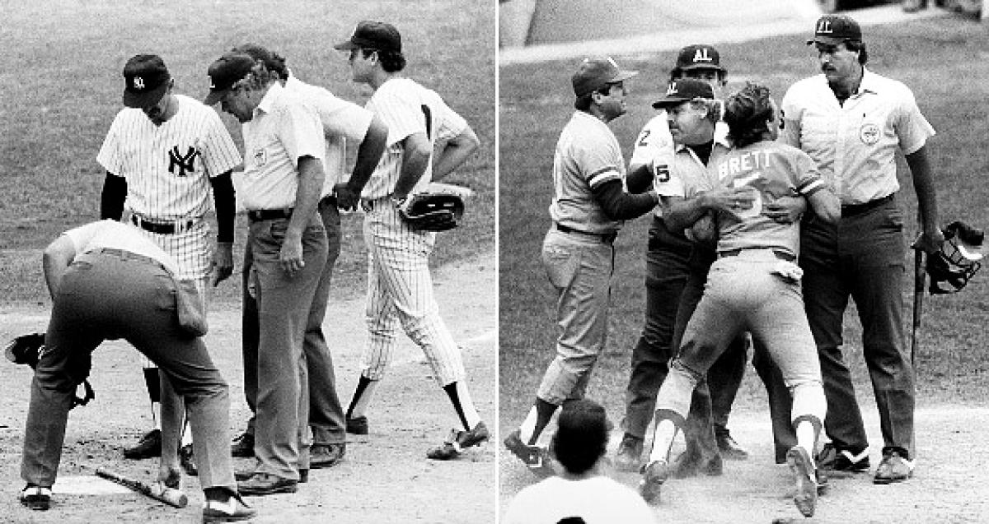
Rule 1.00
1.10 NOTES
Wood bats – can have a grip or tape in length up to 16 inches from the small end.
2 ¾ barrel bats are not allowed in ANY division.
Bat donuts are NOT allowed in ANY division. Get them out of the dugout.
Illegal bats MUST be removed. Make notes of illegal bats in case they show back up.
Use back of voucher to make note if necessary.

Slide 15
Rule 1.00
1.11 – Uniforms
All players must be in matching uniforms.
Pitcher’s undershirt – Must be solid in color, not white or light grey.
Neoprene sleeves are permissible, must be worn under a long sleeve shirt.
Spikes – Major baseball – rubber, Jr/Sr baseball – Metal is allowed.
Jewelry – Not permitted. Exception: Medical alert.
Sunglasses are not considered jewelry, but don’t allow after sunset. Use common sense for other items.

Slide 16
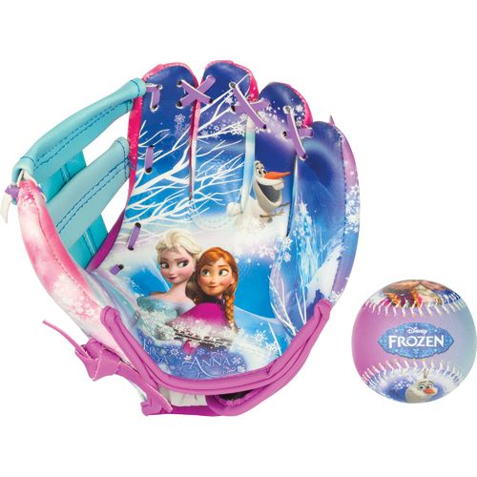
Rule 1.00
1.12 – Catchers must wear a catcher’s mitt. There are no weight, size, or shape restrictions.
1.13 – First Baseman must wear a glove no more than 14 inches long and 8 inches wide
1.14 – All remaining players must wear a glove with the same requirements of 1.13.
1.15 – Pitcher’s glove must not be white, light grey, nor distracting. Pitchers may wear a batting glove. Cannot be white, light grey, or optic yellow.

Slide 17
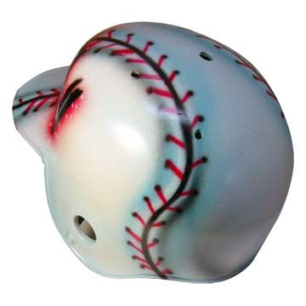
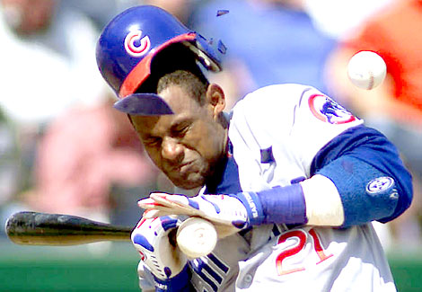
Rule 1.00
1.16 – Helmets
Must be stamped NOCSAE.
Cannot be mirrored or reflective.
“Helmets may not be re-painted and may not contain tape or re-applied decals unless approved in writing by the helmet manufacturer or an authorized dealer.”

Slide 18
Rule 1.00
1.17 – Catcher’s equipment, cups
Catchers in all divisions may wear long or short model chest protectors.
Catcher’s helmet must be stamped NOCSAE.
Catcher’s mask must have a dangling throat protector installed regardless of style.
All male players are required to wear cups at all positions.
Players catching for coaches in pre-game warmups MUST wear a catcher’s helmet. This includes outfield warmups. Umpires may stop warmups until a helmet is worn. C.Y.A!
Catcher’s in the bullpen must wear catcher’s helmet in the crouched position.

